Slide 1
AI-Based Diabetes Prediction System
innovative techniques
Submitted by
M.Reddappa Reddy
Dept:AI and Ds
Reg No:723921243035

Slide 2
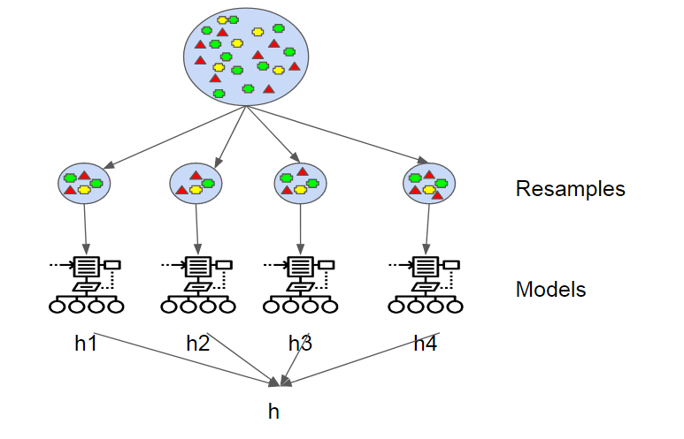
To improve the accuracy and robustness of our AI-based Diabetes Prediction System, we can incorporate innovative techniques and approaches. Here are some of the best techniques, including ensemble methods and deep learning architectures:
Ensemble Methods:

Slide 3
1.Random Forest:
Random Forest is an ensemble learning method that combines multiple decision trees to make predictions. It's known for its robustness and ability to handle noisy data. Using a Random Forest ensemble can enhance prediction accuracy.
2.Gradient Boosting:
Algorithms like XGBoost, LightGBM, and CatBoost are powerful gradient boosting methods that optimize decision trees to minimize prediction errors. They are highly effective in improving model accuracy.
3.Stacking:
Stacking is a technique where multiple diverse models are trained, and their predictions are combined using another model (meta-learner). By stacking different algorithms, you can capture a broader range of patterns in the data.

Slide 4
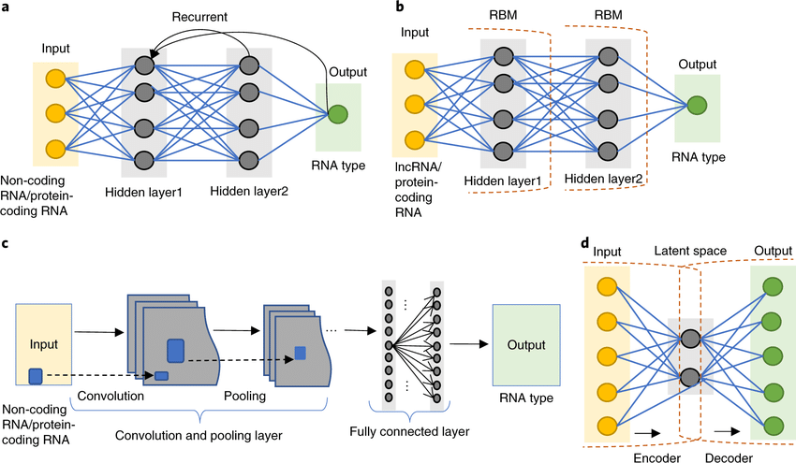
1.Deep Learning Architectures:
1.Convolutional Neural Networks (CNNs):
CNNs are primarily used for image data, but they can also be applied to medical imaging, such as retinal scans. CNNs are effective at feature extraction from image data, which can be a valuable addition to your diabetes prediction system if relevant.

Slide 5
2.Recurrent Neural Networks (RNNs):
RNNs are suitable for sequential data like time series. If you have longitudinal patient data, RNNs can capture temporal dependencies and improve prediction accuracy.
3.Long Short-Term Memory (LSTM) Networks:
LSTMs, a type of RNN, are known for handling long sequences of data. They are useful for analyzing time-series data and can capture both short and long-term dependencies.
Transformers:
Transformers, originally designed for natural language processing, have been adapted to various domains. They excel in sequence-to-sequence tasks and can be applied to structured medical data for prediction tasks.

Slide 6
Transfer Learning:
1.Pre-trained Models:
Leveraging pre-trained deep learning models can save a lot of time and computational resources. Fine-tuning models like BERT (for text data) or pre-trained vision models like VGG, ResNet, or Inception (for medical images) can significantly boost performance.
Feature Engineering:
1.AutoML:
Automated Machine Learning tools like AutoML can help in feature selection, engineering, and hyperparameter tuning, saving time and potentially discovering novel features.
2. Dimensionality Reduction:
Techniques like Principal Component Analysis (PCA) or t-Distributed Stochastic Neighbor Embedding (t-SNE) can help reduce the dimensionality of your data while retaining essential information.

Slide 7
Model Interpretability:
SHAP Values:
SHAP (SHapley Additive exPlanations) values provide feature-level explanations for model predictions, increasing trust and interpretability.
LIME:
Local Interpretable Model-agnostic Explanations (LIME) generates local model explanations to understand why specific predictions were made.
Data Augmentation:
In medical data, it's often difficult to collect a vast amount of labeled data. Data augmentation techniques like rotation, scaling, and noise injection can artificially increase your training data and improve model generalization.
Handling Class Imbalance:
SMOTE (Synthetic Minority Over-sampling Technique): If you have imbalanced classes, SMOTE can be used to oversample the minority class, helping the model learn from it effectively.
Cost-sensitive Learning:
Adjust the model's training process to focus on minimizing the misclassification of the minority class.

Slide 8
the choice of techniques should be data-dependent. It's crucial to experiment with different methods, evaluate their performance, and fine-tune your model based on the specific characteristics of your diabetes prediction dataset. Additionally, regularly updating your model with new data and research findings is essential to maintain accuracy and robustness over time.

